Slide 1
Introduction to Modern Computer Graphics
School of Software
Shandong University

Slide 2
三维物体表面的表示方法
参数样条(Parameterized Spline)表示
r = (x(u, v), y(u, v), z(u, v))
网格(Mesh)表示
v_{i} = (x_{i}, y_{i}, z_{i}), f_{i} = (v_{j}, v_{k}, v_{l})
点云(Point Cloud)表示
P_{i} = (x_{i}, y_{i}, z_{i})
隐函数(Implicit Function)表示
F(x, y, z) = 0

Slide 3
Representing Surfaces
Triangle meshes
Surface analogue of polylines, this is what GPUs draw
Tensor Product Splines
Surface analogue of spline curves
Subdivision surfaces
Implicit surfaces
f(x, y, z)=0
Procedural
e.g. surfaces of revolution, generalized cylinder
From volume data (medical images, etc.)

Slide 4
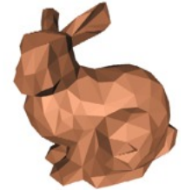
Polygonal Meshes
To represent a surface using polygons
E.g. triangle represented by 3 vertices
Pro: simple, can be rendered directly
Cons: not smooth, needs many triangles to approximate smooth surfaces (tessellation)

Slide 5
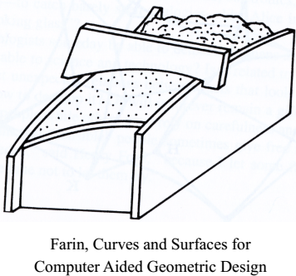
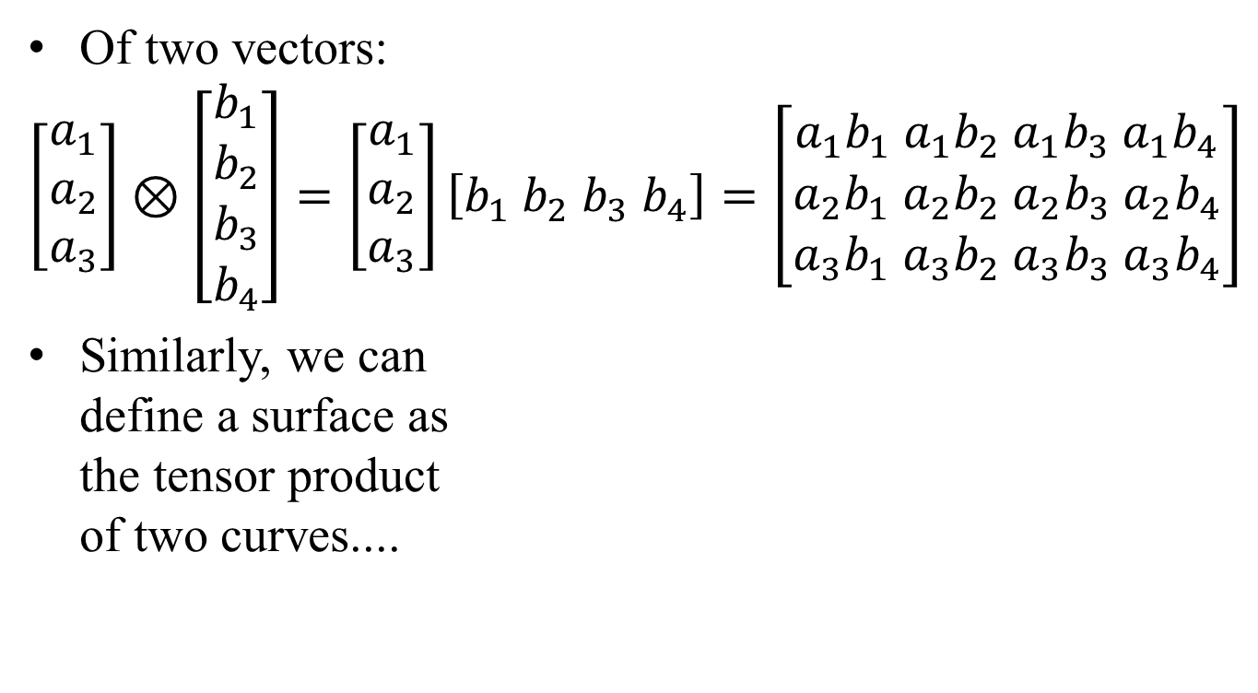
Tensor Product
Of two vectors:
$$\left[\begin{matrix}a_{1} \\ a_{2} \\ a_{3}\end{matrix}\right]⊗\left[\begin{matrix}b_{1} \\ b_{2} \\ b_{3} \\ b_{4}\end{matrix}\right]=\left[\begin{matrix}a_{1} \\ a_{2} \\ a_{3}\end{matrix}\right]\left[b_{1} b_{2} b_{3} b_{4}\right]=\left[\begin{matrix}a_{1}b_{1} a_{1}b_{2} a_{1}b_{3} a_{1}b_{4} \\ a_{2}b_{1} a_{2}b_{2} a_{2}b_{3} a_{2}b_{4} \\ a_{3}b_{1} a_{3}b_{2} a_{3}b_{3} a_{3}b_{4}\end{matrix}\right]$$
Similarly, we can define a surface as the tensor product of two curves....

Slide 6
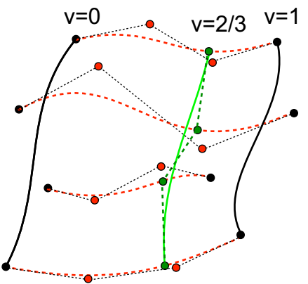
Tensor Product Bézier Patches
Let’s make the P_{i}s move along Bézier curves!
Each u=const. & v=const. curve is a Bézier curve!
Note that the boundary control points (except corners) are NOT interpolated!

Slide 7
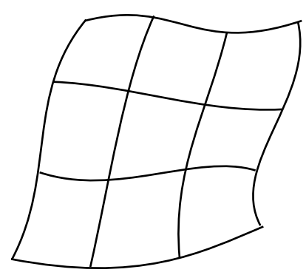
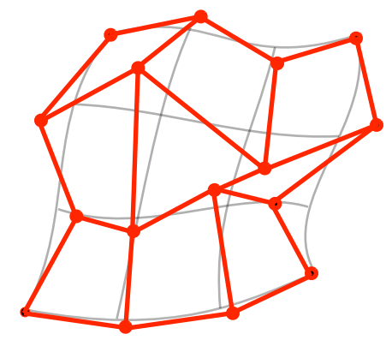
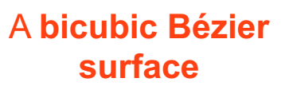
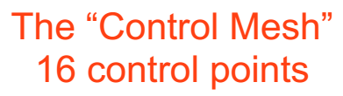
Tensor Product Bézier Patches

Slide 8
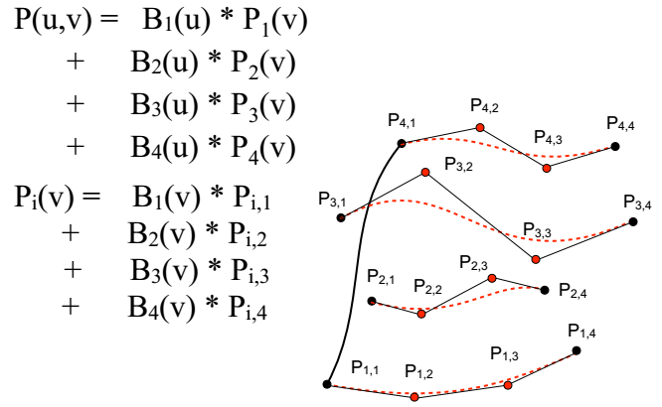
Bicubics, Tensor Product

Slide 9
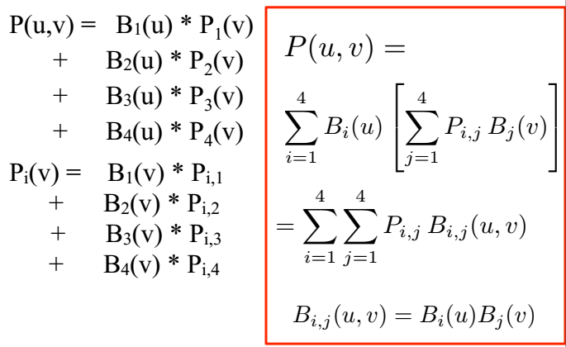
Bicubics, Tensor Product

Slide 10
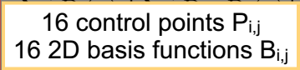
Bicubics, Tensor Product

Slide 11
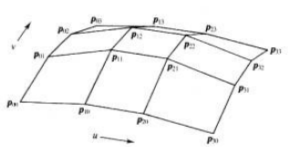
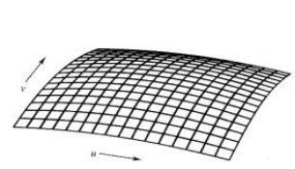
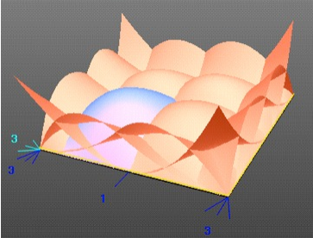
Tensor Bézier Patches
Parametric surface P(u,v) is a cubic polynomial of two variables u & v
Defined by 4 × 4 = 16 control points P_{1,1}, P_{1,2}.... P_{4,4}
Interpolates 4 corners, approximates others
Basis are product of two Bernstein polynomials: B₁(u)B₁(v); B₁(u)B₂(v);... B₄(u)B₄(v)

Slide 12
参数曲面
u曲线
v曲线
曲面方程：r(u, v) = (x(u, v), y(u, v), z(u, v))
u曲线：参数v固定时r(u, v)表示的曲线
v曲线：参数u固定时r(u, v)表示的曲线
参数u的意义：u曲线上的刻度，v曲线的编号
参数v的意义：v曲线上的刻度，u曲线的编号

Slide 13
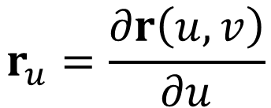
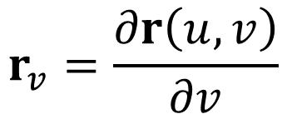
参数偏导
$$r_{v}=\frac{∂r\left(u,v\right)}{∂v}$$
$$r_{u}=\frac{∂r\left(u,v\right)}{∂u}$$
r_{u}的几何意义：曲面上一点在u曲线上的切线
r_{v}的几何意义：曲面上一点在v曲线上的切线

Slide 14
曲面的第一类基本量
r_{v}
r_{u}
E = g_{uu} = r_{u}·r_{u}
F = g_{uv} = r_{u}·r_{v}
G = g_{vv} = r_{v}·r_{v}
第一类基本量的几何意义：E和F分别反映了u曲线和v曲线相邻刻度的距离，G反映了u曲线和v曲线的夹角，它们在本质上反映了参数的分布

Slide 15
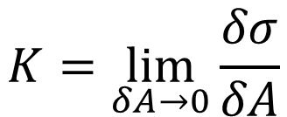
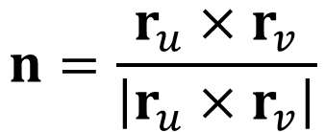
参数曲面的法向量
$$n=\frac{r_{u}×r_{v}}{\left|r_{u}×r_{v}\right|}$$
r_{v}
r_{u}
$$K=\lim_{δA→0}{\frac{δσ}{δA}}$$
把参数曲面的法向量的初始端移到一点，法向量的末端构成球面的一部分，这个球称为高斯球
高斯球被用来研究曲面的弯曲性质

Slide 16
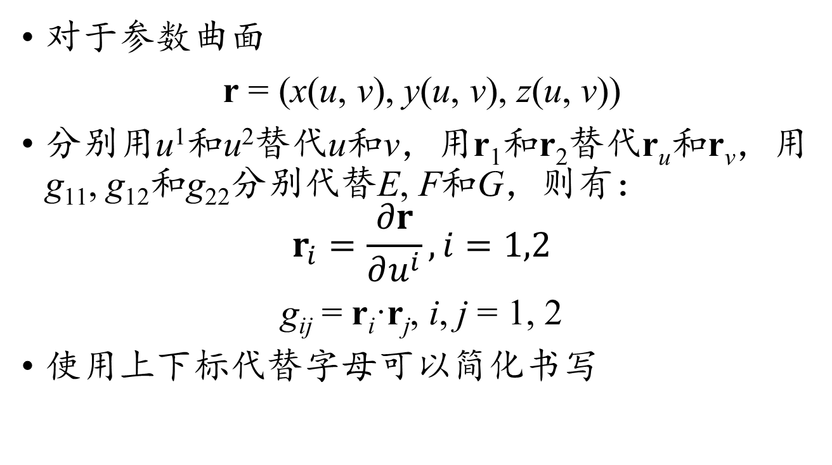
曲面参数的克利斯托费尔写法
对于参数曲面
r = (x(u, v), y(u, v), z(u, v))
分别用u¹和u²替代u和v，用r₁和r₂替代r_{u}和r_{v}，用g₁₁, g₁₂和g₂₂分别代替E, F和G，则有：
$$r_{i}=\frac{∂r}{∂u^{i}},i=1,2$$
g_{ij} = r_{i}·r_{j}, i, j = 1, 2
使用上下标代替字母可以简化书写

Slide 17
参数曲面上的对偶标架
在参数曲面
r = (x(u¹, u²), y(u¹, u²), z(u¹, u²))
中，r₁和r₂构成一个局部的标架，切平面上的向量t都可以通过r₁和r₂的线性组合来表示
t = t¹r₁ + t²r₂
如果切平面上一个向量f满足：
f·r_{i} = f_{i}, i =1, 2
如何用f₁和f₂表示向量f？

Slide 18
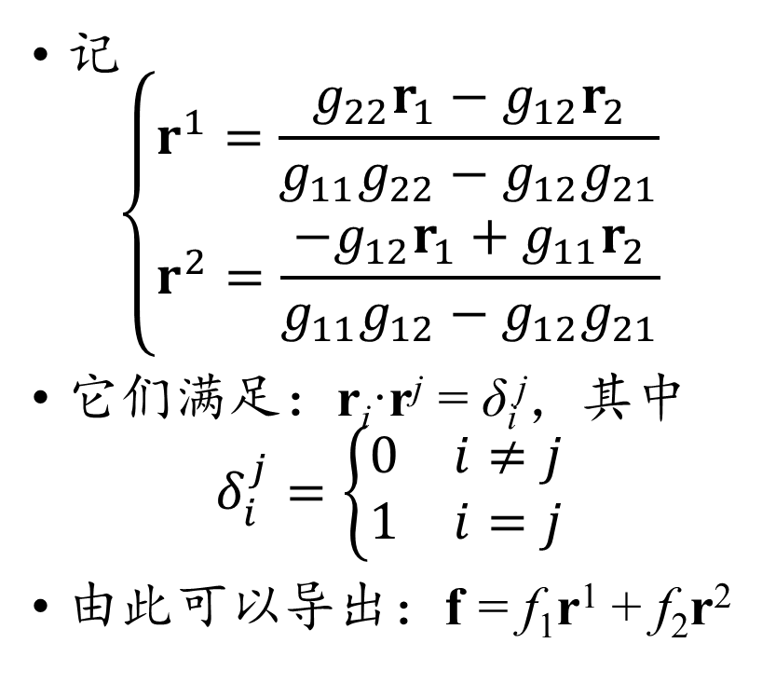
参数面上的对偶标架
r²
记
$$\left\{\begin{matrix}r^{1}=\frac{g_{22}r_{1}−g_{12}r_{2}}{g_{11}g_{22}−g_{12}g_{21}} \\ r^{2}=\frac{−g_{12}r_{1}+g_{11}r_{2}}{g_{11}g_{12}−g_{12}g_{21}}\end{matrix}\right.$$
它们满足：r_{i}·r^{j} = δ_{i}^{j}，其中
$$δ_{i}^{j}=\left\{\begin{matrix}0 & i≠j \\ 1 & i=j\end{matrix}\right.$$
由此可以导出：f = f₁r¹ + f₂r²
r₂
r₁
r¹

Slide 19
参数面上的对偶标架
标架{r¹, r²}称为{r₁, r₂}的对偶标架，利用对偶标架可以更简洁表示出曲面上的更多几何量
使用对偶标架作点积可以导出对偶第一类基本量：
g^{ij} = r^{i}·r^{j}
不难验证它们的换算关系：
g_{i1}g^{1j} + g_{i2}g^{2j} = δ_{i}^{j}, i, j = 1, 2
r^{i} = g^{i1}r₁ + g^{i2}r₂, i, j = 1, 2
r_{i} = g_{i1}r¹ + g_{i2}r², i, j = 1, 2

Slide 20
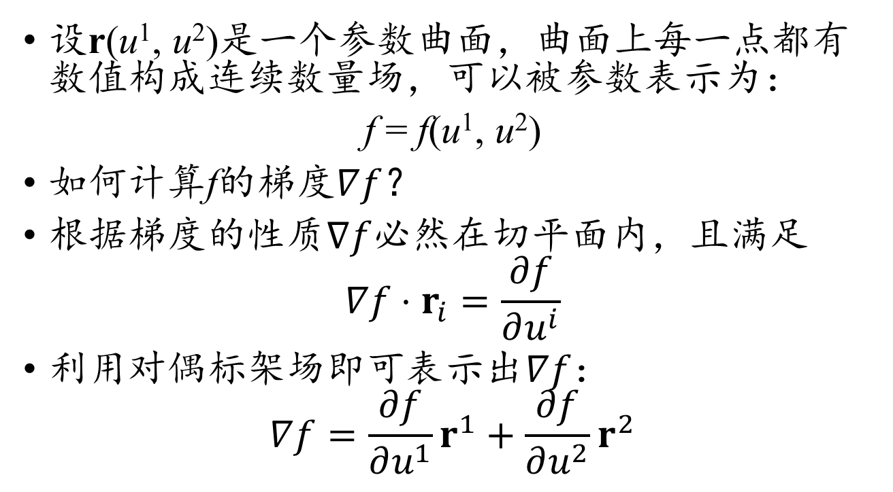
参数曲面上的数量场的梯度
设r(u¹, u²)是一个参数曲面，曲面上每一点都有数值构成连续数量场，可以被参数表示为：
f = f(u¹, u²)
如何计算f的梯度$∇f$？
根据梯度的性质$∇f$必然在切平面内，且满足
$$∇f⋅r_{i}=\frac{∂f}{∂u^{i}}$$
利用对偶标架场即可表示出$∇f$：
$$∇f=\frac{∂f}{∂u^{1}}r^{1}+\frac{∂f}{∂u^{2}}r^{2}$$

Slide 21
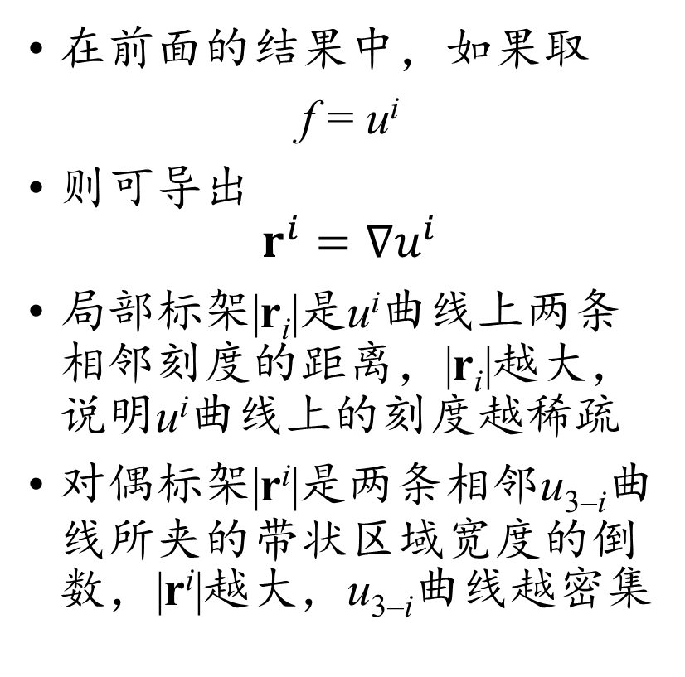
对偶标架的几何意义
在前面的结果中，如果取
f = u^{i}
则可导出
$$r^{i}=∇u^{i}$$
局部标架|r_{i}|是u^{i}曲线上两条相邻刻度的距离，|r_{i}|越大，说明u^{i}曲线上的刻度越稀疏
对偶标架|r^{i}|是两条相邻u_{3–i}曲线所夹的带状区域宽度的倒数，|r^{i}|越大，u_{3–i}曲线越密集
r²
r₂
r₁
r¹

Slide 22
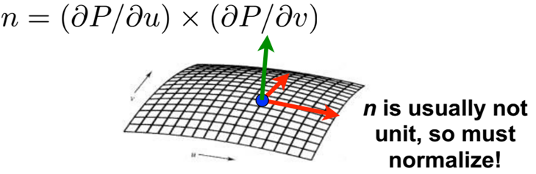
Tangents and Normals for Patches
P(u,v) is a 3D point specified by u, v
The partial derivatives ∂P/∂u and ∂P/∂v are 3D vectors
Both are tangent to surface at P
Normal is perpendicular to both, i.e.,

Slide 23
参数曲面的第二类基本量
对于参数曲面r(u¹, u²)，当一点在曲面上移动时，法向量n也随之移动，把法向量的偏导记为：
法向量n满足：
n·r_{i} = 0
为寻找n变化规律，对上式两边对u^{j}求偏导
n_{j}·r_{i} + n·r_{ij} = 0
记n·r_{ij} = L_{ij}，称为曲面的第二类基本量

Slide 24
参数曲面法向量的移动规律
利用第二类基本量可以简化为：
n_{j}·r_{i} = –L_{ij}
根据法向量的单位性质，有
n·n = 1
两边对u_{i}求导，
2n·n_{i} = 0
这说明n的导数在曲面的切平面内，可以写为：
n_{i} = L_{i1}r¹ + L_{i2}r²

Slide 25
参数曲面的高斯曲率
当点在曲面的一个区域内运动时，对应的法向量在高斯球上的分布区域面积即为高斯曲率K，它满足：K(r₁×r₂) = (n₁×n₂)
利用对偶基向量，可以导出
r₁×r₂ = (g₁₁g₂₂ – g₁₂g₂₁)r¹×r²
根据前面推导的n_{i}，有
n₁×n₂ = (L₁₁L₂₂ – L₁₂L₂₁)r¹×r²
于是导出

Slide 26
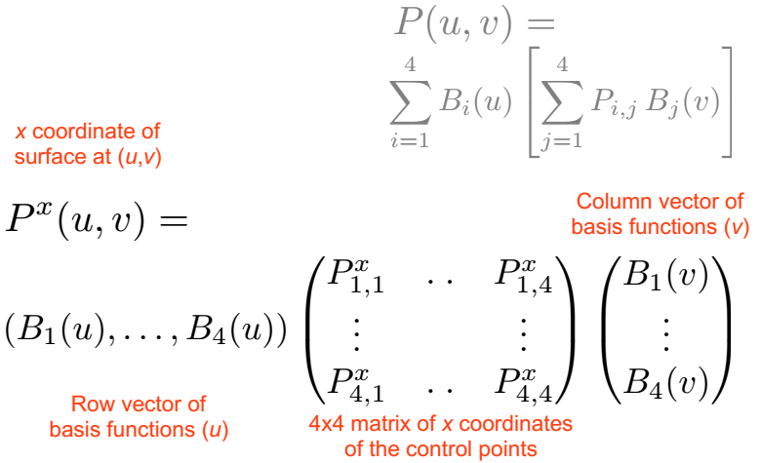
Matrix Notation for Patches

Slide 27
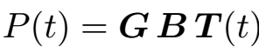
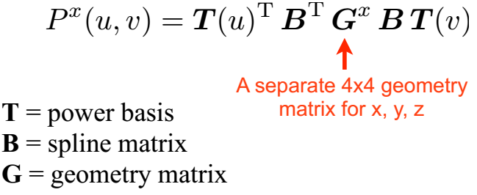
Matrix Notation for Patches
Curves:
Surfaces:

Slide 28
Tensor Product Spline Patches
Pros
Smooth
Defined by reasonably small set of points
Cons
Harder to render (usually converted to triangles)
Tricky to ensure continuity at patch boundaries
Extensions
Rational splines: Splines in homogeneous coordinates
NURBS: Non-Uniform Rational B-Splines
Like curves: ratio of polynomials, non-uniform location of control points, etc.

Slide 29
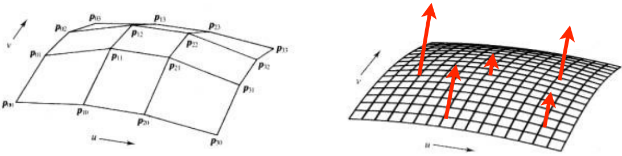
Displacement Mapping
Not all surfaces are smooth...
“Paint” displacements on a smooth surface
For example, in the direction of normal
Tessellate smooth patch into fine grid, then add displacement D(u,v) to vertices
Heavily used in movies, more and more in games

Slide 30
网格表示示例
三角网格(Triangular Mesh)

Slide 31
网格表示示例
四边形网格(Quadrilateral Mesh)

Slide 32
三角网格的特点
优势：
每个面都是平面
不用再分割易于绘制
离散化的微分方程计算简单
不足：
结构性差，难以形成规整分块
难以构造连续度更高的样条

Slide 33
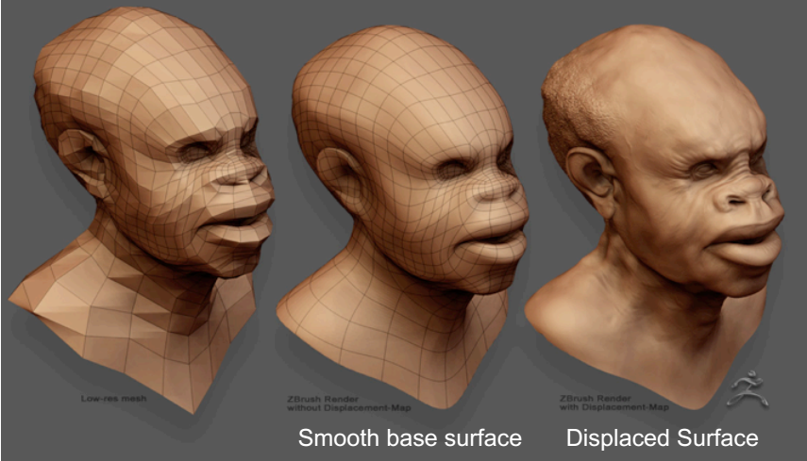
Displacement Mapping Example

Slide 34
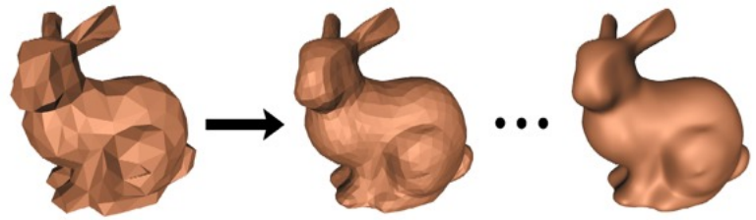
Subdivision Surfaces
Start with polygonal mesh
Subdivide into larger number of polygons, smooth result after each subdivision
Lots of ways to do this.
The limit surface is smooth!
Used everywhere in movie and game modeling!

Slide 35
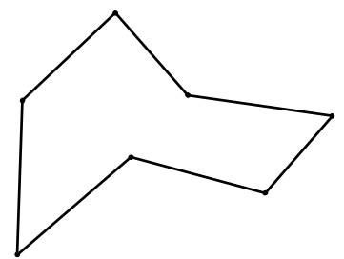
Corner Cutting

Slide 36
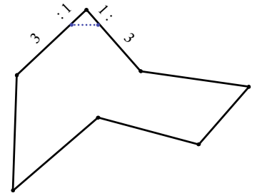
Corner Cutting

Slide 37
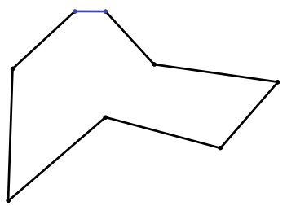
Corner Cutting

Slide 38
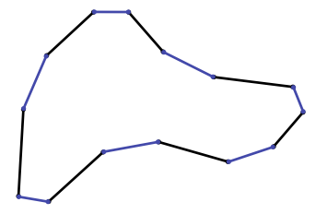
Corner Cutting

Slide 39
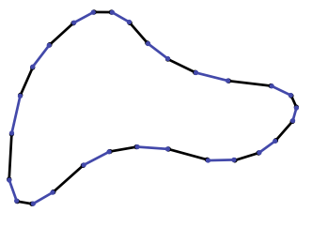
Corner Cutting

Slide 40
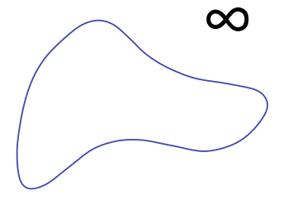
Corner Cutting

Slide 41
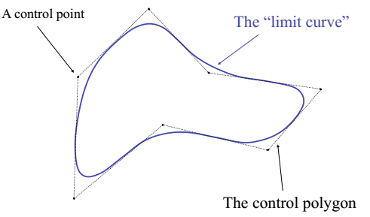
Corner Cutting

Slide 42
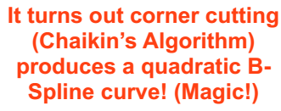
Corner Cutting

Slide 43
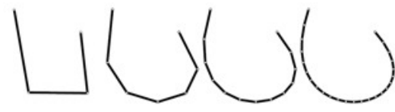
Subdivision Curves and Surfaces
Idea: cut corners to smooth
Add points and compute
weighted average of neighbors
Same for surfaces
Special case for irregular vertices
vertex with more or less than 6 neighbors in a triangle mesh

Slide 44
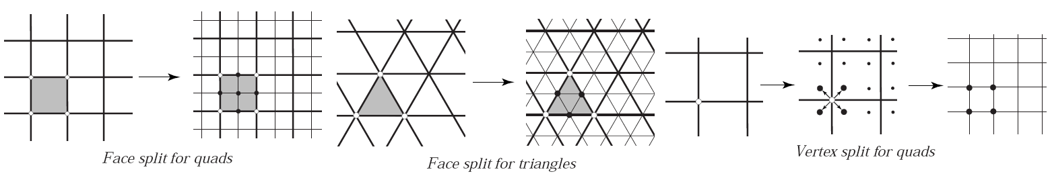
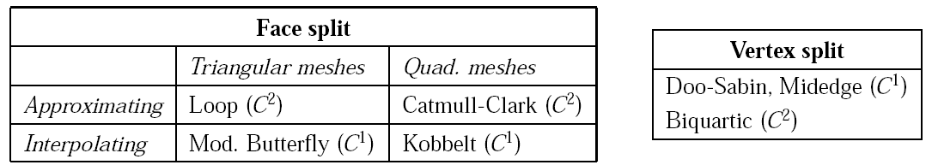
Polygonal Mesh Subdivision
There are different subdivision schemes
Different methods for topology refinement
Different rules for positioning vertices
Interpolating vs. approximating

Slide 45
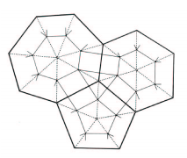
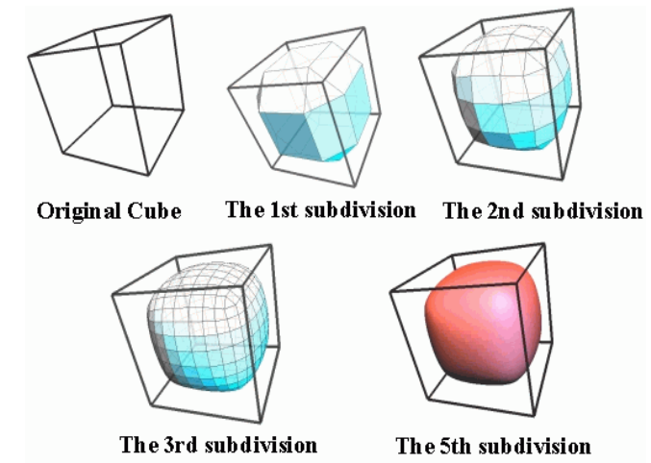
Doo-Sabin Subdivision
Introduce a new vertex for each face. At the midpoint of old vertex and face centroid

Slide 46
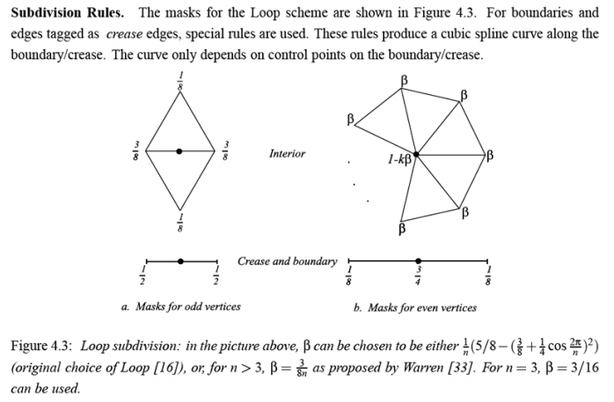
Loop Subdivision
Odd → inserted
Even →inherited

Slide 47
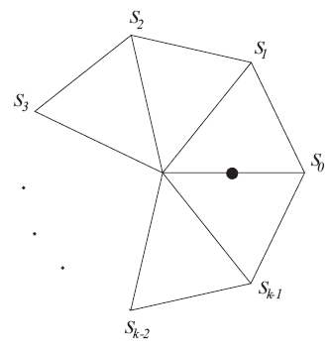
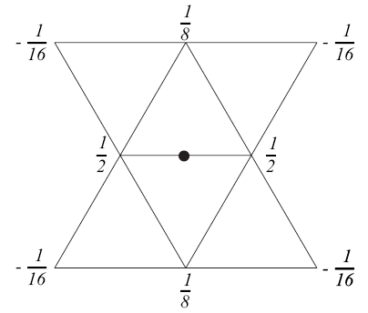
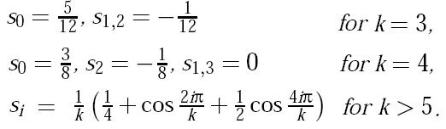
Modified Butterfly Subdivision
Inserts 1 vertex for each edge, e:
Case (a):both ends of e have a valence of 6
Case (b):one end is k-vertex (k ≠ 6)
(a)
(b)

Slide 48
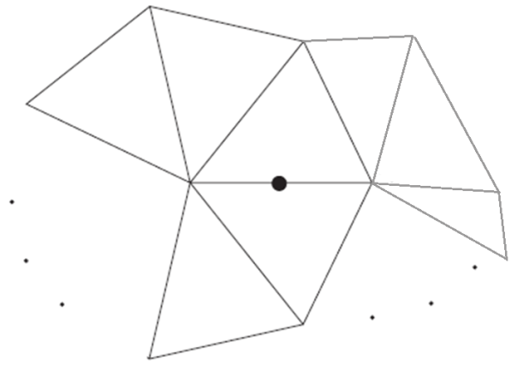
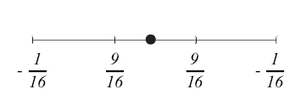
Modified Butterfly Subdivision
Case (c):both ends are k-vertices (k!= 6)
Compute 2 (b)-cases and take the average
Case (d):boundary or crease
(c)
(d)

Slide 49
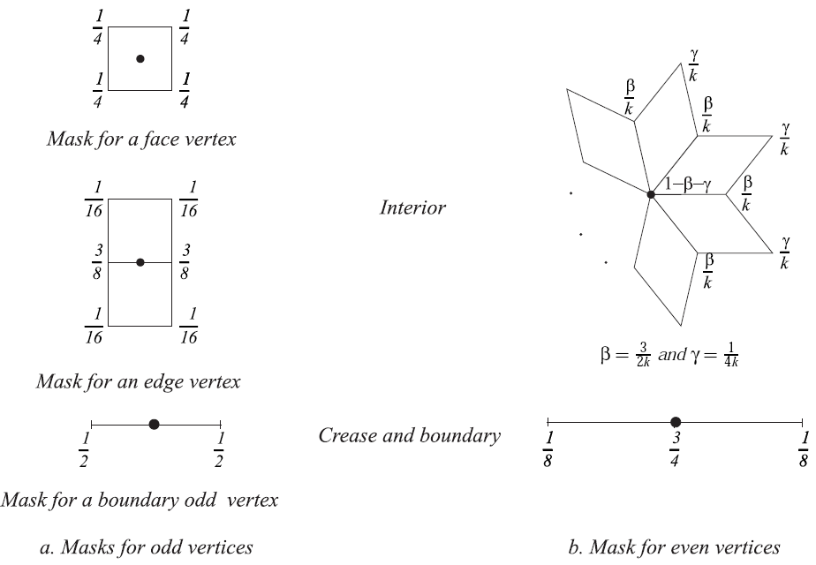
Catmull-Clark Subdivision
For quad-meshes
Has been generalized for arbitrary polygonal meshes

Slide 50
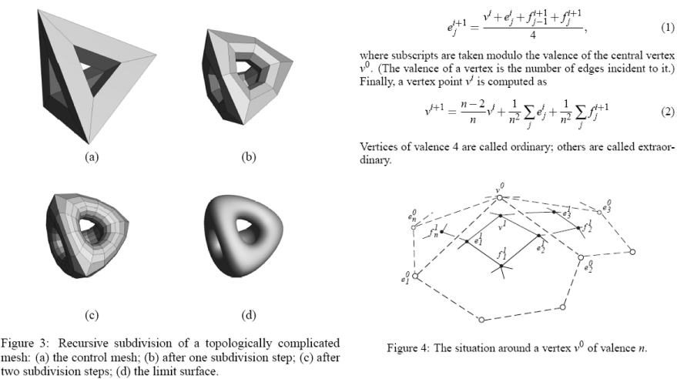
Catmull-Clark Subdivision

Slide 51

Comparison

Slide 52

Comparison

Slide 53

Comparison

Slide 54

“Piecewise Smooth Surface Reconstruction”
Hoppe et al, SIGGRAPH 1994

Slide 55
基于正多面体的构造
正多面体是最基本的三维对称图形

Slide 56

Specialized Procedural Definitions
Surfaces of revolution
Rotate given 2D profile curve
Generalized cylinders
Given 2D profile and 3D curve, sweep the profile along the 3D curve

Slide 57

Surface of Revolution
2D curve q(u) provides one dimension
Note: works also with 3D curve
Rotation R(v) provides 2nd dimension

Slide 58


General Swept Surfaces
Trace out surface by moving a profile curve along a trajectory
profile curve q(u) provides one dimension
trajectory c(u) provides the other
Surface of revolution can be seen as a special case where trajectory is a circle

Slide 59

Normals for Swept Surfaces

Slide 60

Normals for Swept Surfaces

Slide 61

Normals for Swept Surfaces

Slide 62

Normals for Swept Surfaces

Slide 63

Normals for Swept Surfaces

Slide 64

Normals for Swept Surfaces

Slide 65

Normals for Swept Surfaces

Slide 66

Implicit Surfaces
For a sphere: H(x, y, z) = x² + y² + z² – r²
If H(x, y, z) = 0, on surface
If H(x, y, z) > 0, outside surface
If H(x, y, z) < 0, inside surface

Slide 67
Implicit Surfaces
Pros:
Can handle weird topology for animation
Easy to do sketchy modeling
Some data comes this way (medical & scientific data)
Cons:
Does not allow us to easily generate a point on the surface

Slide 68


Level Set Methods
Evolving interfaces
change position and shape in response to the particular physics at work
Breaking waves in the ocean
Dancing flames in the fireplace
……

Slide 69

Example
A level set representation
To add an extra dimension to the problem
The Level Set Surface (in red) plots the distance from each point (x, y) to the Interface (in blue)

Slide 70

Example
A level set representation
To add an extra dimension to the problem

Slide 71

Marching Cubes
Extract triangle mesh from signed distance field
"Marching Cubes: A High Resolution 3D Surface Construction
Algorithm”, Lorensen and Cline, SIGGRAPH '87

Slide 72

Marching Tetrahedra
Jules Bloomenthal, “An implicit surface polygonizer”, Graphics
Gems IV

Slide 73


Example
“Interval volume tetrahedrization”
Visualization '97, Nielson & Sung

